Slide 1
Image Steganography
Shriya setru
hu21csen0101351

Slide 2
Table of contents
Introduction
Methodology
Python Modules
Summary

Slide 3
Introduction
This is an introduction to the Steganography application that I had built which allows the users to secure information by hiding the original message or text behind a secret or encrypted text.
The application also allows the users to decrypt the message, and also allows them to extract text from images and encrypt them.
I based the GUI of my application on tkinter library available with python.

Slide 4
What is Steganography?
The basic idea behind steganography is concealing one piece of information within another in such a way that the existence of the hidden information is difficult to detect. Unlike cryptography, which focuses on making the content of a communication secret, steganography aims to hide the fact that a message is being communicated at all.
My main focus has been on Image Steganography which involves extracting and encrypting text or information present in any image.
Steganography has various applications, including secure communication, copyright protection, and digital watermarking. It's important to note that while steganography can hide the existence of a message, it does not necessarily encrypt the message itself.

Slide 5
Where can it be applied?
Concealing messages within images can provide a level of security during military or intelligence communication.
It can be used in embedding digital watermarks within images can help protect intellectual property rights.
In the medical field, steganography can be used to embed patient information or metadata within medical images.
Steganography can be applied to protect privacy in biometric data. For instance, facial features or other biometric information could be hidden within images to preserve individual privacy while still allowing for identification.
Journalists or whistleblowers may use steganography to hide sensitive information within images when communicating with sources or exposing corruption. This can help protect the identity of the individuals involved.

Slide 6
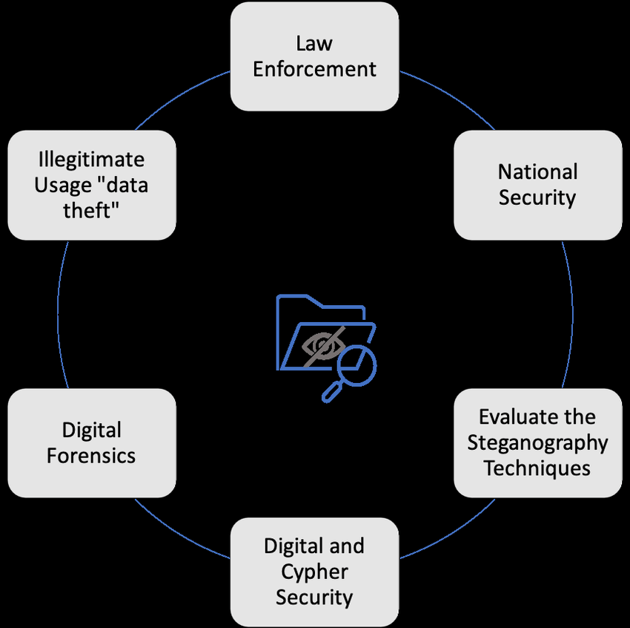

Slide 7
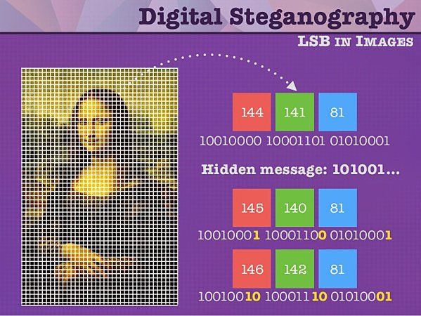
Methodology
I will now explain the core implementation of my application, and what is the main idea behind the working of this small application

Slide 8
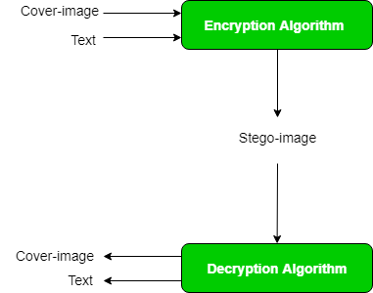
Here the encryption algorithm used is using the least significant bits (LSBs) of the RGB channels involves manipulating the least significant bit of each color channel (Red, Green, and Blue) in the image pixels to encode the binary representation of the hidden text.
We replace the least significant bit of each color channel in the image pixels with the corresponding bits of the binary message. This conceals the text within the image.
The process is reversible, allowing the hidden message to be extracted.

Slide 9
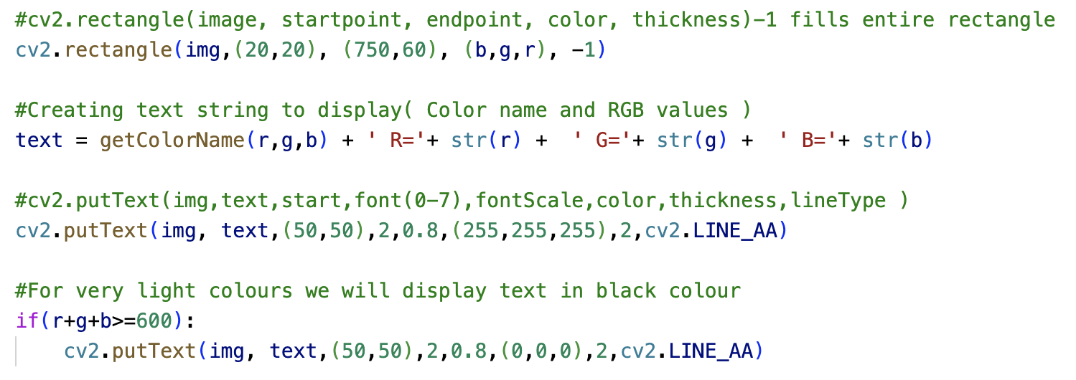
Extracting text from image
For colour detection the core idea was to use several modules namely OpenCV, Pandas, and Numpy.
We make use of an image to detect colours and mask.
We use the pandas module to import the csv files that contain the colour datasets into the python file. The functions that I used in my python code will now compare the RGB values of the colour with that of the colours present in the dataset and give us the name of the colour.
We calculate the minimum distance between all the colours in the image to see which colour is the closest to the pointer

Slide 10
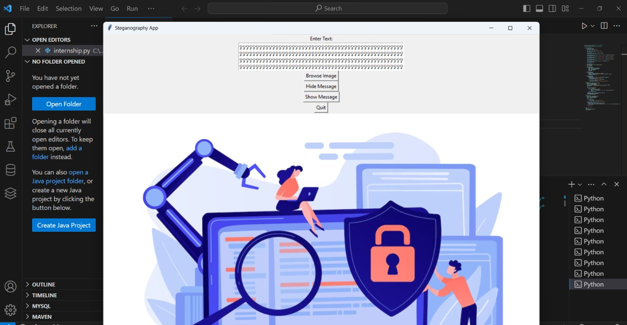

Slide 11
Python Modules used:
I have used several python modules and packages that made working of this small-time application possible and they include:
tkinter
PIL
Cryptography

Slide 12
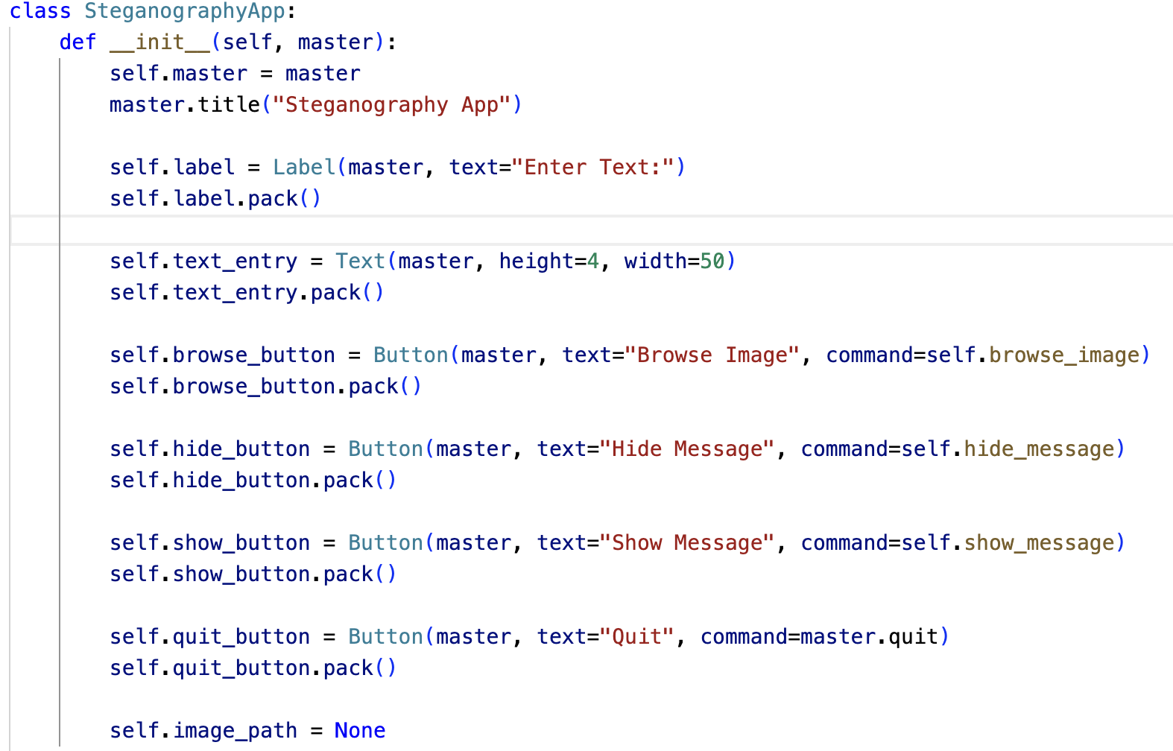
tkinter
Tkinter is the python library that I had implemented to provide a GUI for my application.
Tkinter works on different operating systems, including Windows, macOS, and Linux, providing a consistent interface across platforms.
Tkinter can be easily integrated with other Python libraries and frameworks, allowing you to enhance your GUI applications with additional functionalities.
Tkinter supports the creation of dialog boxes, making it easy to create pop-up windows for messages, warnings, prompts, etc.

Slide 13
Fernet
Fernet is a symmetric encryption algorithm, meaning that the same key is used for both encryption and decryption. This contrasts with asymmetric encryption, where separate keys are used for these operations.
Fernet handles key management internally. Users only need to generate a key and use it for encryption and decryption. The library takes care of secure key storage and rotation.
Fernet is easy to use and suitable for developers who want a straightforward way to encrypt and decrypt data without dealing with complex cryptographic operations.

Slide 14
Summary
This app is designed for hiding secret information within images. Steganography involves concealing the existence of the information, providing a covert means of communication.
Users will be able to extract hidden information from steganographic images. This involves selecting a steganographic image, applying the extraction process, and decrypting the retrieved data.
There are the alterations in the pixels but not visible to the human eye. That is the biggest reason that this technique is one of the best techniques used in the information security for the data hiding and secured communication.
It allows lossless compression of the cover image. The size, the quality of the original cover image and the secret text embedded image (stego image) remains unchanged.

